Slide 1
Operating Systems
Lecture 9

Slide 2
Agenda for Today
Review of previous lecture
UNIX/Linux IPC tools and associated system calls
UNIX/Linux standard files and kernel’s mechanism for file access
Use of pipe in a program and at the command line
Recap of the lecture

Slide 3
Review of Lecture 8
Interprocess communication (IPC)
  Establish link and use send/recv
  Issues about links: establishing links, link capacity, links per pair of processes, processes per link, message size, uni- or bi-directional
Direct communication
Indirect communication

Slide 4
Review of Lecture 8
Process synchronization
Buffering capacity of a link
IPC in UNIX and Linux
  Pipe, FIFO, Socket, etc.
  Per process file descriptor table
  pipe, read, write, close system calls

Slide 5
UNIX/Linux IPC Tools
Pipe: For communication between related processes on a system
P1
P2
Pipe
UNIX/Linux System

Slide 6
UNIX/Linux IPC Tools
Named pipe (FIFO): For communication between unrelated processes on a system
P1
P2
FIFO
UNIX/Linux System

Slide 7
UNIX/Linux IPC Tools
Socket: For communication between unrelated processes on the same or different systems
P1
P2
Network Connection
Socket
Socket
Computer 1
Computer 2

Slide 8
UNIX/Linux Pipe
Important system calls
open, read, write, close, pipe
  open: Open or create a file
  read: Read from a pipe
  write: Write data to a pipe
  close: Close/destroy a pipe
  pipe: Create a pipe for IPC

Slide 9
open System Call
#include <sys/types.h>
#include <sys/stat.h>
#include <fcntl.h>
int open (const char *path, int oflag,
/* mode_t mode */ ...);
‘oflag’ specifies purpose of opening the file and ‘mode’ specifies permission on the file if it is to be created.

Slide 10
open System Call
Returns a file descriptor on success and –1 on failure
Can specify that read and write will be blocking or non-blocking
‘oflag’ value is constructed by ORing various flags: O_RDONLY, O_WRONLY, O_RDWR, O_NDELAY (or O_NONBLOCK), O_APPEND, O_CREAT, etc.

Slide 11
open System Call
Call fails
  Non-existent file
  Operation specified is not allowed due to file permissions
  Search not allowed on a component of pathname
  User’s disk quota on the file system has been exhausted

Slide 12
open System Call
Call fails
  No write permission on the directory in which the file is being created
  Signal was caught during open
  Process has reached the limit of maximum open files
  System limit reached on maximum number of simultaneous open files

Slide 13
read System Call
#include <sys/types.h>
#include <sys/uio.h>
#include <unistd.h>
ssize_t read(int fildes, void *buf, size_t nbyte);
Returns number of bytes read or -1
Call fails and errno set accordingly
  Invalid ‘fildes’, ‘buf’, or ‘nbyte’
  Signal caught during read

Slide 14
write System Call
#include <sys/types.h>
#include <unistd.h>
ssize_t write (int fildes, const void *buf,
size_t nbyte);
Returns the number of bytes written or -1

Slide 15
write System Call
Call fails
  Invalid argument
  File size limit for process or for system would exceed
  Disk is full

Slide 16
File Descriptor to File Contents
Per Process File Descriptor Table
File Descriptor
File Table
Inode Table
0
1
2
3
4
OPEN_MAX — 1
File’s contents
…
…
…
…
…

Slide 17
Standard Descriptors in UNIX/Linux
Three files are automatically opened for every process for the process to read its input from and send its output and error messages to. These files are called standard files: standard input, standard output, and standard error.

Slide 18
Standard Descriptors in UNIX/Linux
By default, standard files are attached to the terminal on which a process runs
Descriptors for standard files are known as standard file descriptors.
  Standard input: 0 (keyboard)
  Standard output: 1 (display screen)
  Standard error: 2 (display screen)

Slide 19
pipe() Call
int pipe (int pipedes[2]);
Call fails
  At least two slots not empty in the PPFDT—too many files or pipe open in the process
  Buffer space not available in the kernel
  File table is full

Slide 20
UNIX/Linux Pipe
Important characteristics of a pipe
  Used for communication between related processes
  Used as half-duplex channel
  Bounded buffer
  Maximum data written is PIPE_BUF (defined in <sys/param.h> in UNIX and in <linux/param.h> in Linux)—5120 and 4096, respectively

Slide 21
Example
child
parent
fork
P
P
Read end
Write end

Slide 22
Sample Code
/* Parent creates pipe, forks a child, child writes into
pipe, and parent reads from pipe */
#include <stdio.h>
#include <sys/types.h>
#include <sys/wait.h>
main()
{
int pipefd[2], pid, n, rc, nr, status;
char *testString = "Hello, world!\n“, buf[1024];

Slide 23
Sample Code
rc = pipe (pipefd);
if (rc < 0) {
perror("pipe");
exit(1);
}
pid = fork ();
if (pid < 0) {
perror("fork");
exit(1);
}

Slide 24
Sample Code
if (pid == 0) { /* Child’s Code */
close(pipefd[0]);
write(pipefd[1], testString, strlen(testString));
close(pipefd[1]);
exit(0);
}

Slide 25
Sample Code
/* Parent’s Code */
close(pipefd[1]);
n = strlen(testString);
nr = read(pipefd[0], buf, n);
rc = write(1, buf, nr);
wait(&status);
printf("Good work child!\n");
return(0);
}

Slide 26
Command Line Use of Pipes
Connect standard output of a command to standard input of another
Use the pipe operator, |
Syntax:
cmd1 | cmd2 | … | cmdN

Slide 27
Command Line Use of Pipes
cmd1 | cmd2 | … | cmdN
cmd1
pipe
cmd2
pipe
pipe
cmdN

Slide 28
Command Line Use of Pipes
cat /etc/passwd | grep zaheer
cat
Display Screen
pipe
grep

Slide 29
Without Using a Pipe
cat /etc/passwd | grep zaheer
$ cat /etc/passwd > temp1
$ grep “zaheer” temp1
$ rm temp1

Slide 30
Recap of Lecture
Review of previous lecture
UNIX/Linux IPC tools and associated system calls
UNIX/Linux standard files and kernel’s mechanism for file access
Use of pipe in a program and at the command line
Recap of the lecture

Slide 31
Operating Systems
Lecture 10

Slide 32
Agenda for Today
Review of previous lecture
Input, output, and error redirection in UNIX/Linux
FIFOs in UNIX/Linux
Use of FIFOs in a program and at the command line
Recap of lecture

Slide 33
Review of Lecture 9
UNIX/Linux IPC tools and associated system calls
UNIX/Linux standard files and kernel’s mechanism for file access
Use of pipe in a program and at the command line

Slide 34
Input, Output, Error Redirection
You can use the Linux redirection features to detach the default files from stdin, stdout, and stderr and attach other files with them.

Slide 35
Input Redirection
Input Redirection:
command < input-file
command 0< input-file
Purpose: Detach keyboard from stdin
and attach ‘input-file’ to it,
i.e., ‘command’ reads input
from ‘input-file’ and not
keyboard

Slide 36
Input Redirection
$ cat < Phones
[ contents of Phones ]
$ grep “Nauman” < Phones
[ output of grep ]
$

Slide 37
Output Redirection
Output Redirection:
command > output-file
command 1> output-file
Purpose: Detach the display screen
from stdout and attach
‘output-file’ to it, i.e.,
‘command’ sends output to
‘output-file’ and not the
display screen

Slide 38
Output Redirection
$ cat > Phones
[ your input ]
<Ctrl-D>
$ grep “Ali” Phones > Ali.phones
[ output of grep ]
$ find ~ -name foo -print > foo.log
[ error messages ]
$

Slide 39
Error Redirection
Error Redirection:
command 2> error-file
Purpose: Detach the display screen
from stderr and attach ‘error-
file’ to it, i.e., error messages
are sent to ‘error-file’ and not
the display screen

Slide 40
Error Redirection
$ find ~ -name foo -print 2> errors
[ output of the find command ]
$ ls -l foo 2> error.log
[ output of the find command ]
$ cat error.log
ls: foo: No such file or directory
$ find / -name ls -print 2> /dev/null
/bin/ls
$

Slide 41
UNIX/Linux FIFOs
IPC for communication between related or unrelated processes on a computer
P1
P2
FIFO
UNIX/Linux System

Slide 42
UNIX/Linux FIFOs
A file type in UNIX
Created with mknod() or mkfifo() system call or by mkfifo command

Slide 43
UNIX/Linux FIFOs
Unlike a pipe, a FIFO must be opened before using it for communication
A write to a FIFO that no process has opened for reading results in a SIGPIPE signal

Slide 44
UNIX/Linux FIFOs
When the last process to write to a FIFO closes it, an EOF is sent to the reader
Multiple processes can write to a FIFO ➔ atomic writes to prevent interleaving of multiple writes

Slide 45
UNIX/Linux FIFOs
Two common uses of FIFOs
  In client-server applications, FIFOs are used to pass data between a server process and client processes
  Used by shell commands to pass data from one shell pipeline to another, without creating temporary files

Slide 46
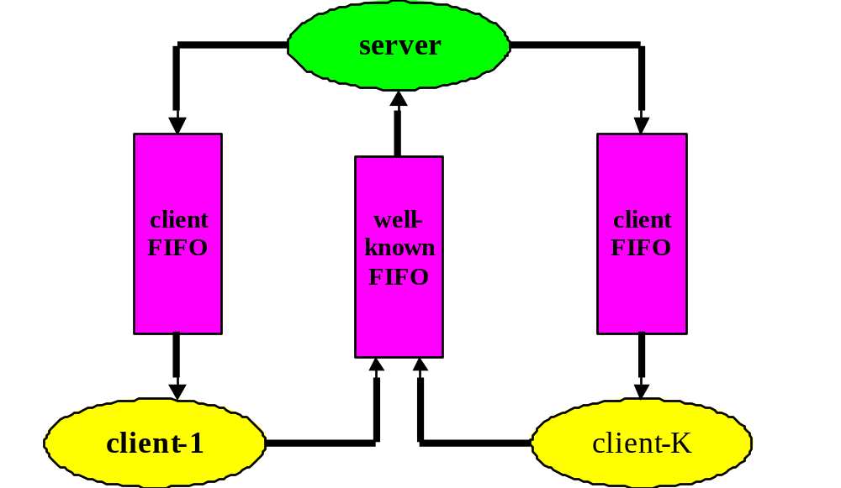
Client-Server Communication with FIFOs

Slide 47
Creating FIFOs
mknod system call
  Designed to create special (device) files
mkfifo Command
mkfifo C library call
  Invokes mknod system call

Slide 48
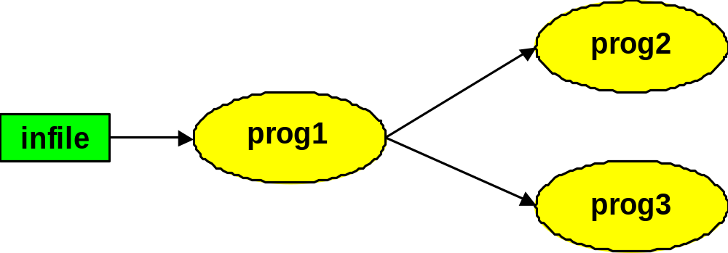
Command Line Use of FIFOs
$ mkfifo fifo1
$ prog3 < fifo1 &
$ prog1 < infile | tee fifo1 | prog2
[ Output ]
$

Slide 49
Command Line Use of FIFOs
$ man ls > ls.dat
$ cat < fifo1 | grep ls | wc -l &
[1] 21108
$ sort < ls.dat | tee fifo1 | wc -l
31
528
$
grep
wc -l
fifo1
Pipe
infile
sort
tee
Pipe
wc -l

Slide 50
Recap of Lecture
Review of previous lecture
Input, output, and error redirection in UNIX/Linux
FIFOs in UNIX/Linux
Use of FIFOs at the command line
Recap of lecture

Slide 51
Operating Systems
Lecture 11

Slide 52
Agenda for Today
Review of previous lecture
Use of FIFOs in a program
Example code
Process management commands in UNIX/Linux
Recap of lecture

Slide 53
Review of Lecture 10
Input, output, and error redirection
Use of FIFOs at the command line
UNIX/Linux commands: cat, find, grep, mkfifo, tee, wc

Slide 54
mknod System Call
#include <sys/types.h>
#include <sys/stat.h>
int mknod (const char *path, mode_t mode,
dev_t dev);
‘mode’ should be permission mode OR-ed with S_IFIFO
‘dev’ is set to 0 for a FIFO

Slide 55
mknod System Call
mknod fails:
  File with the given name exists
  Pathname too long
  A component in the pathname not searchable, non-existent, or non-directory
  Destination directory is read-only
  Not enough memory space available
  Signal caught during mknod

Slide 56
mkfifo Library Call
#include <sys/types.h>
#include <sys/stat.h>
int mkfifo(const char *path, mode_t mode);
‘mode’ sets permission on FIFO
Calls mknod

Slide 57
mkfifo Library Call
mkfifo fails:
  File with the given name exists
  Pathname too long
  A component in the pathname not searchable, non-existent, or non-directory
  Destination directory is read-only
  Not enough memory space available
  Signal caught during mkfifo

Slide 58
Example
FIFO1
Server
Client
FIFO2
Display Screen

Slide 59
Client-Server Code
#include <stdio.h>
#include <string.h>
#include <sys/types.h>
#include <sys/stat.h>
#include <sys/errno.h>
extern int errno;
#define FIFO1 "/tmp/fifo.1"
#define FIFO2 "/tmp/fifo.2"
#define PERMS 0666
#define MESSAGE1 "Hello, world!\n"
#define MESSAGE2 "Hello, class!\n"

Slide 60
Server Code
#include "fifo.h“
main()
{
char buff[BUFSIZ];
int readfd, writefd;
int n, size;
if ((mknod (FIFO1, S_IFIFO | PERMS, 0) < 0)
&& (errno != EEXIST)) {
perror ("mknod FIFO1");
exit (1);
}

Slide 61
Server Code
if (mkfifo(FIFO2, PERMS) < 0) {
unlink (FIFO1);
perror("mknod FIFO2");
exit (1);
}
if ((readfd = open(FIFO1, 0)) < 0) {
perror ("open FIFO1");
exit (1);
}
if ((writefd = open(FIFO2, 1)) < 0) {
perror ("open FIFO2");
exit (1);
}

Slide 62
Server Code
size = strlen(MESSAGE1) + 1;
if ((n = read(readfd, buff, size)) < 0) {
perror ("server read"); exit (1);
}
if (write (1, buff, n) < n) {
perror("server write1"); exit (1);
}
size = strlen(MESSAGE2) + 1;
if (write (writefd, MESSAGE2, size) != size) {
perror ("server write2"); exit (1);
}
close (readfd); close (writefd);
}

Slide 63
Client Code
#include "fifo.h"
main()
{
char buff[BUFSIZ];
int readfd, writefd, n, size;
if ((writefd = open(FIFO1, 1)) < 0) {
perror ("client open FIFO1"); exit (1);
}
if ((readfd = open(FIFO2, 0)) < 0) {
perror ("client open FIFO2"); exit (1);
}

Slide 64
Client Code
size = strlen(MESSAGE1) + 1;
if (write(writefd, MESSAGE1, size) != size) {
perror ("client write1"); exit (1);
}
if ((n = read(readfd, buff, size)) < 0) {
perror ("client read"); exit (1);
}
else
if (write(1, buff, n) != n) {
perror ("client write2"); exit (1);
}
close(readfd); close(writefd);

Slide 65
Client Code
/* Remove FIFOs now that we are done using them */
if (unlink (FIFO1) < 0) {
perror("client unlink FIFO1");
exit (1);
}
if (unlink (FIFO2) < 0) {
perror("client unlink FIFO2");
exit (1);
}
exit (0);
}

Slide 66
Running the Code
$ gcc server.c –o server
$ gcc client.c –o client
$ server &
[1] 432056
$ client
Hello, world!
Hello, class!
$

Slide 67
Managing Unix/Linux Processes
Commonly used process management commands:
  ps – Display status of
  processes
  top – Display CPU usage of
  processes

Slide 68
Managing Unix/Linux Processes
bg – Put a process in the
  background
fg – Bring a process into the
foreground
jobs – Display status of jobs

Slide 69
Managing Unix/Linux Processes
<Ctrl-Z> – Suspend/stop a
process
<Ctrl-C> – Send SIGINT signal
to the foreground
process
kill – Terminate a process

Slide 70
The ps command
ps command prints information about active processes.
Without options, ps prints information about processes owned by the user
Commonly used option: -u, -e, and -l

Slide 71
The ps Command
$ ps
PID TTY TIME CMD
1321 pts/0 00:00:00 csh
1345 pts/0 00:00:00 bash
1346 pts/0 00:00:00 ps
$

Slide 72
The ps Command
$ ps -u root | more
PID TTY TIME CMD
1 ? 00:00:04 init
5 ? 00:00:01 kswapd
712 ? 00:00:00 inetd
799 ? 00:00:00 cron
864 ? 00:00:00 sshd
934 ? 00:00:00 httpd
1029 tty1 00:00:00 getty
...
$

Slide 73
The ps Command
$ ps -e | more
PID TTY TIME CMD
1 ? 00:00:04 init
2 ? 00:00:00 keventd
3 ? 00:00:00 ksoftirqd_CPU0
4 ? 00:00:00 ksoftirqd_CPU1
5 ? 00:00:01 kswapd
6 ? 00:00:00 kreclaimd
7 ? 00:00:00 bdflush
8 ? 00:00:00 kupdated
...
$

Slide 74
The top Command
Displays information about the top processes (as many as can fit on the terminal or around 20 by default) on the system and periodically updates this information.
Raw cpu percentage is used to rank the processes.

Slide 75
The top Command
$ top
9:42am up 5:15, 2 users, load average: 0.00, 0.00, 0.00
55 processes: 54 sleeping, 1 running, 0 zombie, 0 stopped
CPU0 states: 0.0% user, 0.1% system, 0.0% nice, 99.4% idle
CPU1 states: 0.0% user, 0.2% system, 0.0% nice, 99.3% idle
Mem: 513376K av, 237732K used, 275644K free, 60K shrd, 17944K buff
Swap: 257032K av, 0K used, 257032K free 106960K cached
PID USER PRI NI SIZE RSS SHARE STAT %CPU %MEM TIME COMMAND
1406 sarwar 19 0 896 896 700 R 0.3 0.1 0:00 top
1382 nobody 10 0 832 832 660 S 0.1 0.1 0:00 in.telnetd
1 root 9 0 536 536 460 S 0.0 0.1 0:04 init
2 root 9 0 0 0 0 SW 0.0 0.0 0:00 keventd
...
$

Slide 76
Recap of Lecture
Use of FIFOs in a program
Example code
Process management commands in UNIX/Linux (ps, top)
Recap of lecture

Slide 77
Operating Systems
Lecture 12

Slide 78
Agenda for Today
Review of previous lecture
Process management commands: bg, fg, ^Z, jobs, ^C, kill
Thread concept
Pros and cons of threads
User and kernel threads
Pthreads library with example
Recap of lecture

Slide 79
Review of Lecture 11
Use of FIFOs in a program
Sample code
Process management in UNIX/Linux
UNIX/Linux commands/calls: mknod, mkfifo, ps, top

Slide 80
The fg Command
fg [%job_id]
fg resumes the execution of a suspended job in the foreground and moves a background job into the foreground.
If %job_id is omitted the current job is assumed.

Slide 81
The bg command
bg [ %job_id]
bg resumes the execution of a suspended job in the background.
If %job_id is omitted the current job is assumed.
bg runs the current or specified jobs in the background.

Slide 82
The jobs command
jobs
jobs displays status of suspended and background processes.

Slide 83
Suspending a Process
<Ctrl-Z> sends a STOP/SUSPEND signal to the current process. The shell displays a message saying that the job has been suspended and displays its prompt.
You can then manipulate the state of this job, put it in the background with the bg command, run some other commands, and then eventually bring the job back into the foreground with the fg command.

Slide 84
Sample Session
$ find / -name foo -print 2> /dev/null
^Z
[1]+ Stopped find / -name foo -print 2> /dev/null
$ bg
[1]+ find / -name foo -print 2> /dev/null &
$ jobs
[1]+ Running find / -name foo -print 2> /dev/null &
$ fg
find / -name foo -print 2> /dev/null
[ command output ]
$

Slide 85
Terminating Current Process
<Ctrl-C> sends the SIGINT signal to the current process, which, by default, terminates the process.
$ find / -name foo -print 1> out 2> /dev/null
^C
$

Slide 86
Terminating a Process
kill [-signal] PID sends signal number ‘signal’ to process with ID ‘PID’
kill 123 sends the SIGTERM signal to the process with ID 123
kill –9 sends the ‘sure kill’ signal, e.g., kill –9 304294

Slide 87
Terminating a Process
kill –l displays the signals supported by the system and their numbers
$ kill -l
1) SIGHUP 2) SIGINT 3) SIGQUIT 4) SIGILL
5) SIGTRAP 6) SIGABRT 7) SIGEMT 8) SIGFPE
9) SIGKILL 10) SIGBUS 11) SIGSEGV 12) SIGSYS
13) SIGPIPE 14) SIGALRM 15) SIGTERM 16) SIGUSR1
...
$

Slide 88
Issues with Processes
The fork() system call is expensive
IPC is required to pass information between a parent and its child processes.

Slide 89
Thread Concept
A thread is a “lightweight” process which executes within the address space of a process.
A thread can be scheduled to run on a CPU as an independent unit and terminate.
Multiple threads can run simultaneously.

Slide 90
Thread Concept
Threads have their own
  Thread ID
  CPU context (PC, SP, register set, etc.)
  Stack
  Priority
  errno

Slide 91
Thread Concept
Threads share
  Code and data
  Open files (through the PPFDT)
  Current working directory
  User and group IDs
  Signal setups and handlers
  PCB

Slide 92

Single and Multithreaded Processes

Slide 93
Threads are Similar to Processes
A thread can be in states similar to a process (new, ready, running, blocked, terminated)
A thread can create another thread

Slide 94
Threads are Different from Processes
Multiple threads can operate within the same address space
No “automatic” protection mechanism is in place for threads—they are meant to help each other

Slide 95
Advantages of Threads
Responsiveness
  Multi-threaded servers (e.g., browsers) can allow interaction with user while a thread is formulating response to a previous user query (e.g., rendering a web page)

Slide 96
Advantages of Threads
Resource sharing
  Process resources (code, data, etc.)
  OS resources (PCB, PPFDT, etc.)

Slide 97
Advantages of Threads
Economy
  Take less time to create, schedule, and terminate
  Solaris 2: thread creation is 30 times faster than process creation and thread switching is five times faster than process switching

Slide 98
Advantages of Threads
Performance in multi-processor and multi-threaded architectures (e.g., Intel’s P4 HT)
  Multiple threads can run simultaneously

Slide 99
Disadvantages of Threads
Resource sharing— synchronization needed between threads
Difficult to write and debug multi-threaded programs

Slide 100
Recap of Lecture
User and kernel threads
Pthreads
Sample code
UNIX/Linux commands/calls: pthread_create, pthread_join, pthread_exit

